Slide 1
Capstone extra slides
Created, edited, not used in presentation
(additional unused slides in the Tableau and Power BI extracts)

Slide 2
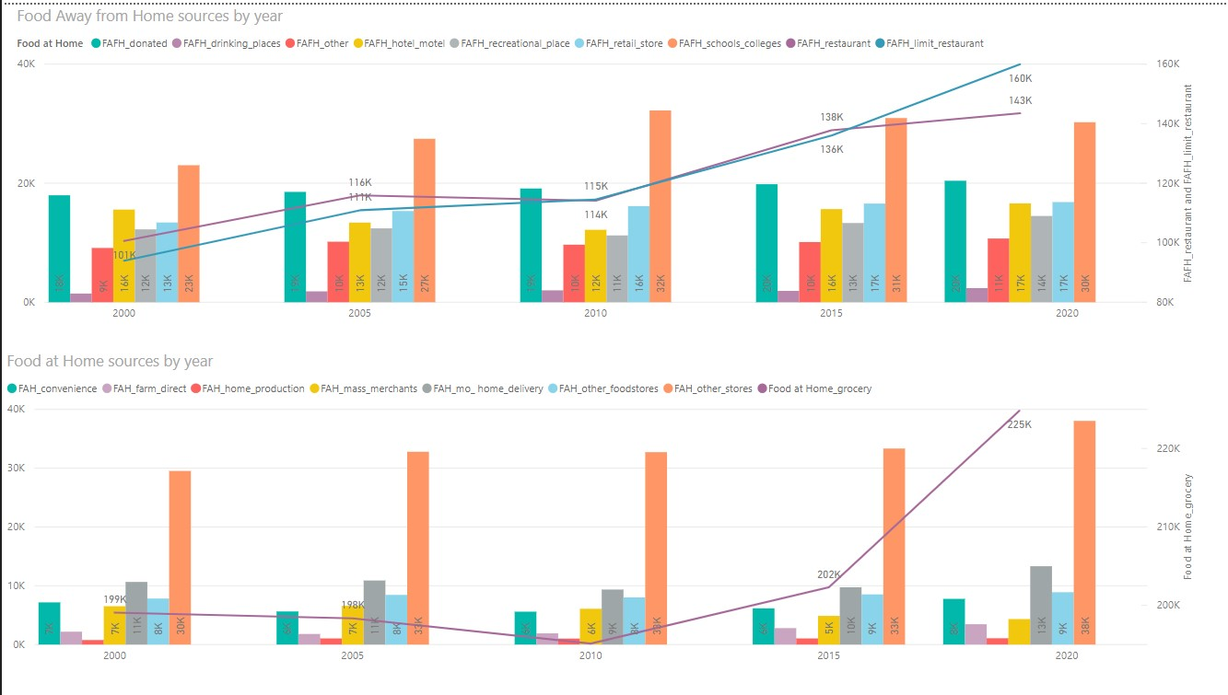

Slide 3
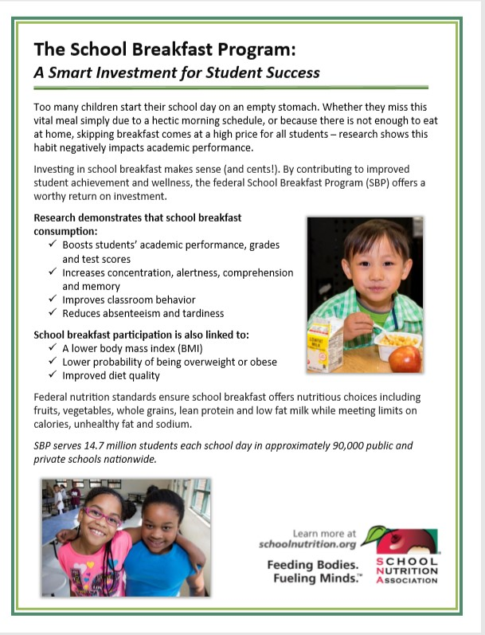
Child Nutrition Programs
NSLP - Nearly 100,000 schools/institutions serve school lunches to 29.8 million students each day,
SBP - Over 90,000 schools/institutions serve school breakfasts to 14.71 million students each day,
Reimbursement Rates for the 2019-20 School Year:
Free School Lunch $3.41 (avg cost to produce $3.81)
Free School Breakfast $1.84 (avg cost to produce $2.72)
These programs are accumulating debt from both the cost of producing meals (45% Labor / Benefits) and from children unable to pay the subsidized cost if ineligible for free meals.
https://schoolnutrition.org/AboutSchoolMeals/SchoolMealTrendsStats/

Slide 4
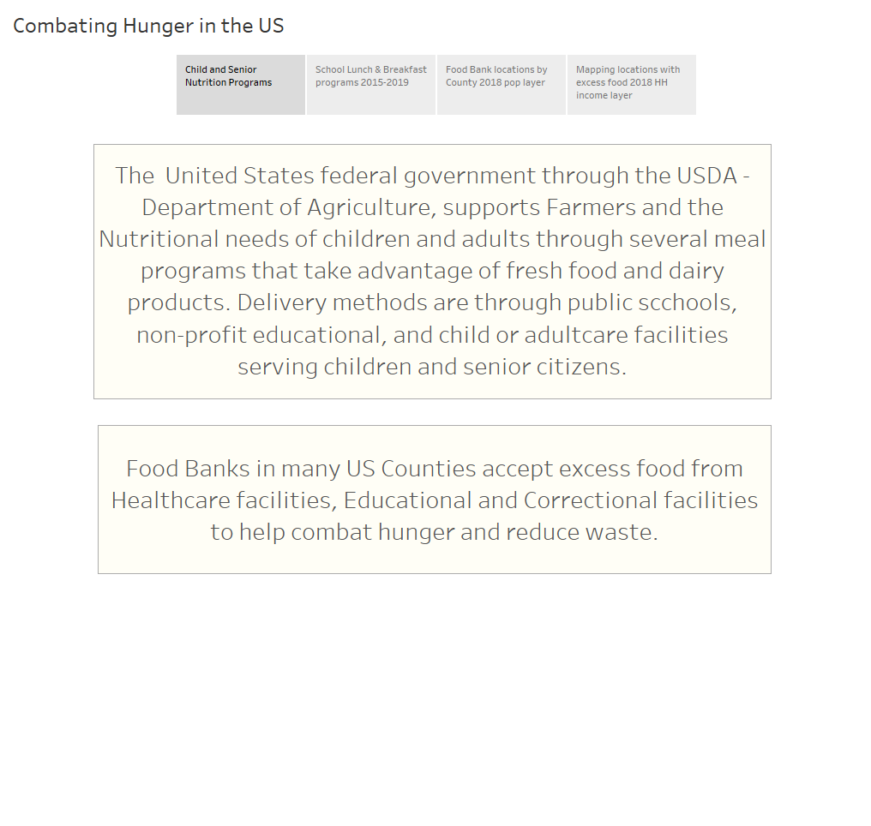

Slide 5
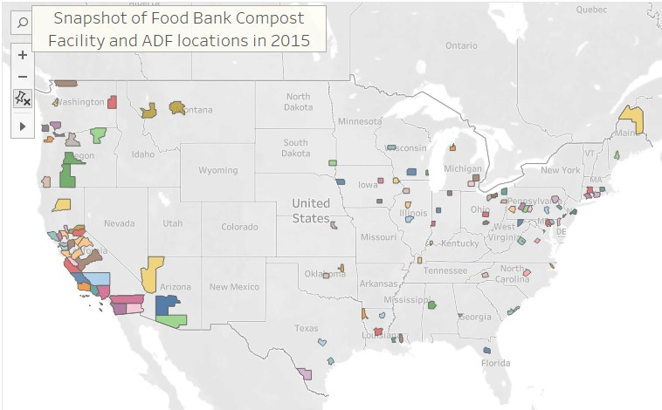
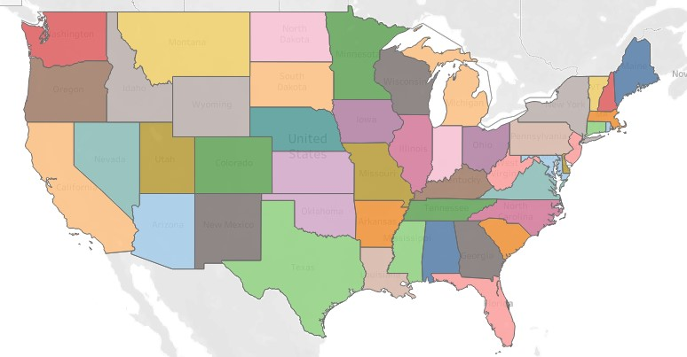
Tableau Geo and State Maps
Local organizations and Food recipients' quick views
Tableau stories and interactivity are well suited for quick visuals of multiple data points across a large data set.
By State meals served to support Child Nutrition
By County Food Banks and Excess Food
LINK to Tableau public

Slide 6
Sources
National School Lunch Program
The National School Lunch Program (NSLP) is a federally assisted meal program operating in public and nonprofit private schools and residential child care institutions. It provides nutritionally balanced, low-cost or free lunches to children each school day. The program was established under the National School Lunch Act, signed by President Harry Truman in 1946.
School Breakfast Program
The School Breakfast Program (SBP) provides reimbursement to states to operate nonprofit breakfast programs in schools and residential childcare institutions. The Food and Nutrition Service administers the SBP at the federal level. State education agencies administer the SBP at the state level, and local school food authorities operate the program in schools.
Summer Food Service Program
The Summer Food Service Program (SFSP) is a federally-funded, state-administered program. SFSP reimburses program operators who serve free healthy meals and snacks to children and teens in low-income areas.
From <https://www.fns.usda.gov/cn>

Slide 7
Sources
Special Milk Program
The Special Milk Program (SMP) provides milk to children in schools and childcare institutions who do not participate in other federal meal service programs. The program reimburses schools for the milk they serve. Schools in the National School Lunch or School Breakfast Programs may also participate in the Special Milk Program to provide milk to children in half-day pre-kindergarten and kindergarten programs where children do not have access to the school meal programs.
Child and Adult Care Food Program
The Child and Adult Care Food Program (CACFP) is a federal program that provides reimbursements for nutritious meals and snacks to eligible children and adults who are enrolled for care at participating child care centers, day care homes, and adult day care centers. CACFP also provides reimbursements for meals served to children and youth participating in afterschool care programs, children residing in emergency shelters, adults over the age of 60 or living with a disability and enrolled in day care facilities. CACFP contributes to the wellness, healthy growth, and development of young children and adults in the United States.

Slide 8
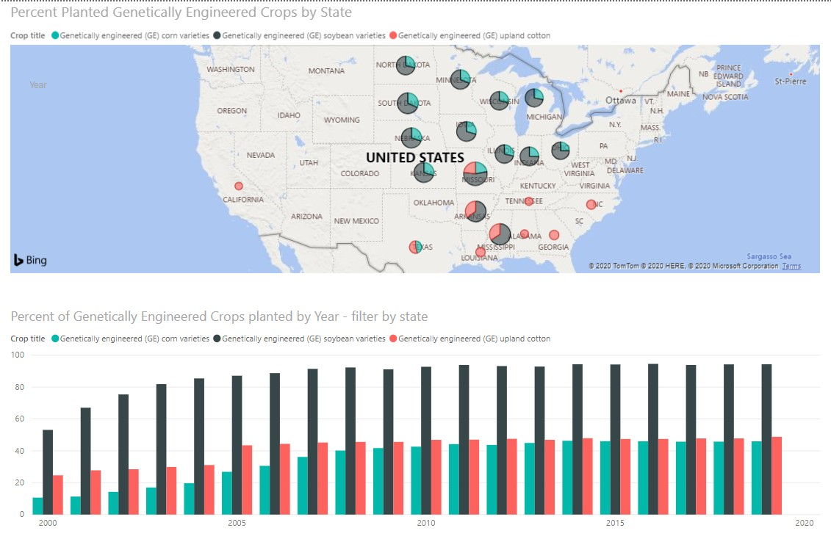
Future study Food Supply and Nutrition The fight against hunger in the United States will be impacted by the availability of nutritious foods for reasonable costs. Genetically engineered crops in the US – 2000 to 2019 GE varieties of corn, soybeans and cotton are genetically modified to enhance nutrition, increase production, and reduce waste due to pests or transportation. New manufacturing techniques give plant-based “burgers” a taste more closely resembling real meat.

